Slide 1

Charles Schwab Sentiment Analysis
Evan, Kristian, Yuming

Slide 2
Should financial services firms be tracking their reputation on reddit?

Slide 3





Tech Stack

Slide 4


schwabV2

Slide 5

Gather Data
Focus on posts and comments
Scrape Data from r/Schwab and across reddit
For analysis we scraped all posts with and comments mentions and then cleaned the data
Notes:
Yuming
Firstly, our focus was on collecting posts. We aimed to understand the general sentiments, opinions, and discussions happening within this community.
To do this, we decided to scrape data directly from the r/Schwab subreddit. The analysis was splite in to two parts the cloud and topic is use the comment the other is use the post for the R/schwab subreddit.
The Data For the dashboard is from r/Schwab Subreddit and the Data for analysis is scraped from across reddit.

Slide 6
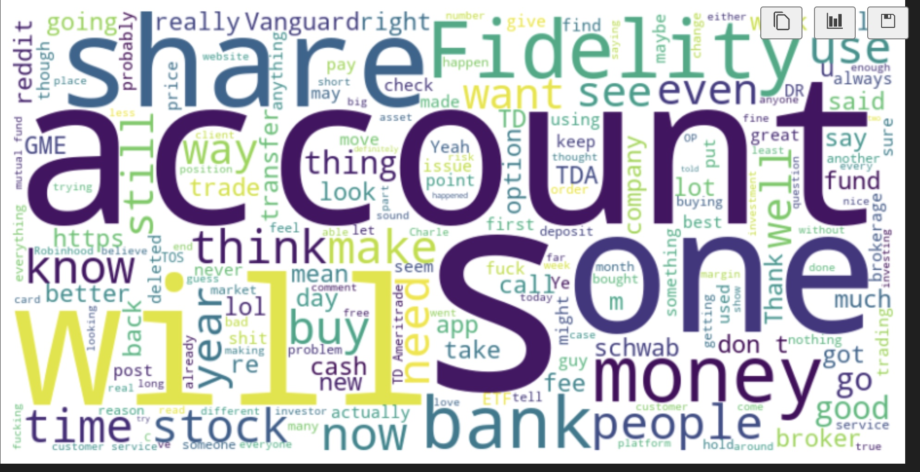
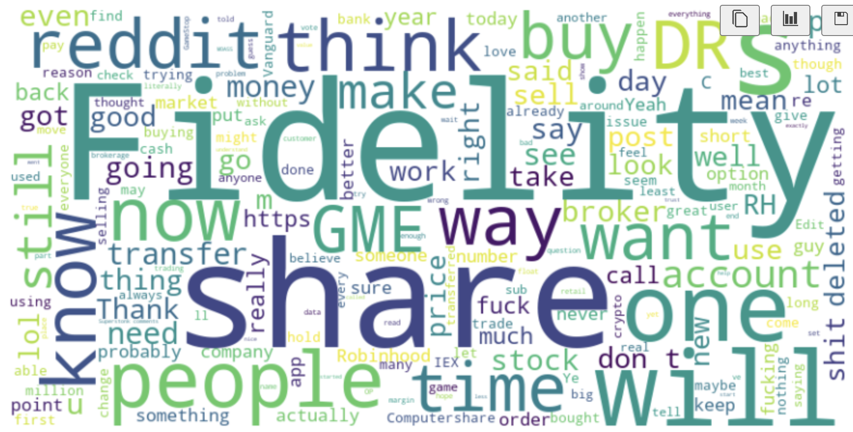
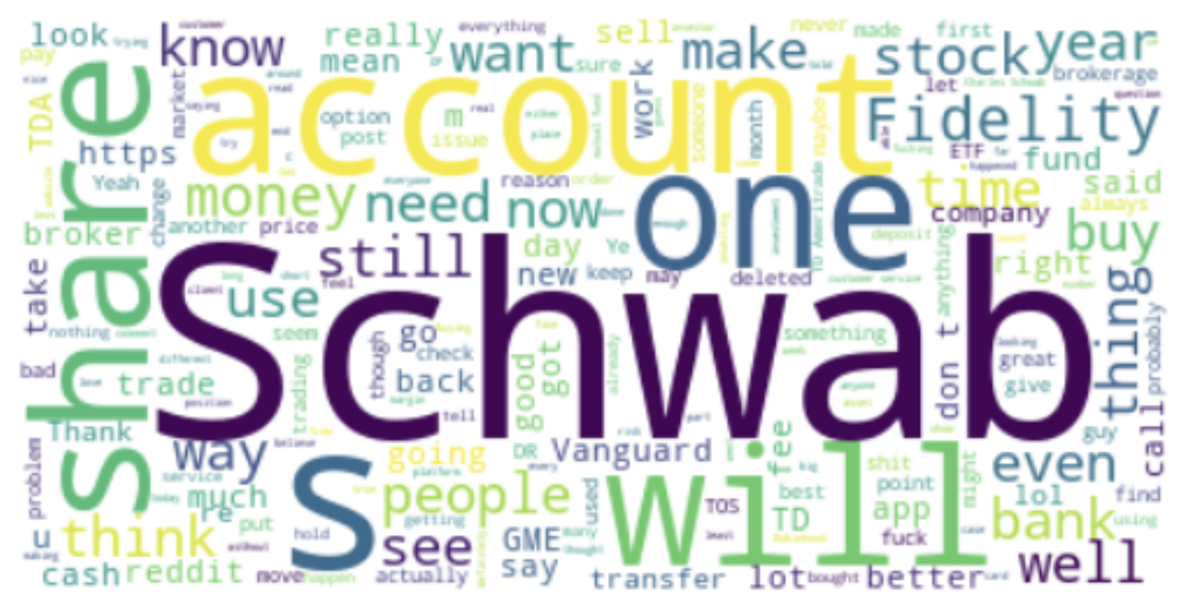
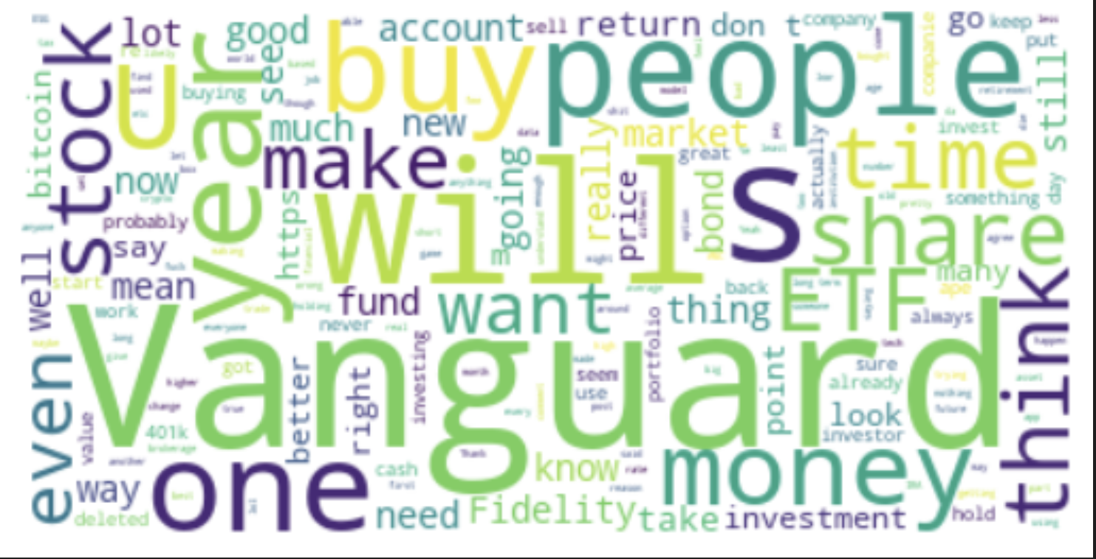
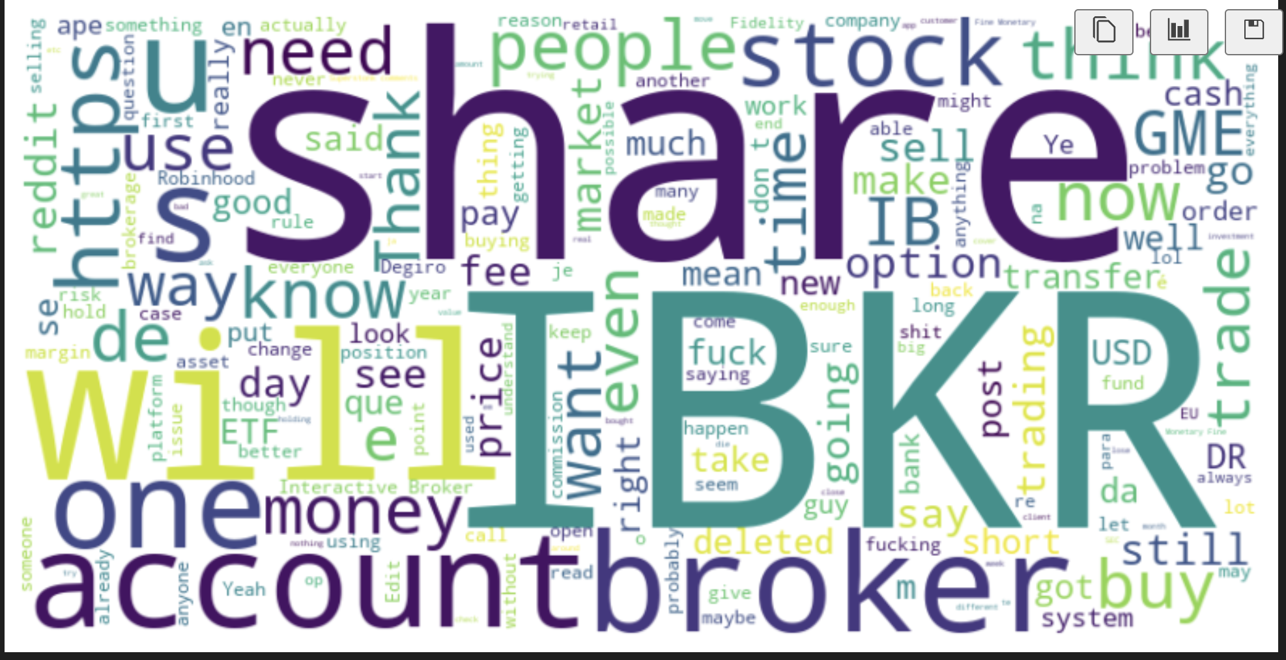
Explore the Data (on comments)
Schwab
Fidelity
Vanguard
IBKR
Notes:
Financial Services and Products:
The prominence of words such as "account," "bank," "money," and "cash" suggests significant discussions around Schwab’s banking services and cash management options.
Discuss the integration of Schwab's banking and brokerage services and how it provides convenience and benefits to customers, such as easier transfer of funds and managing investments.
Customer Experience and Satisfaction:
Terms like "use," "service," and "app" highlight conversations about the user experience, particularly regarding Schwab's digital tools.
It would be relevant to talk about how Schwab is innovating or improving its digital platforms to enhance customer interactions and satisfaction.
Comparison with Competitors:
Again, competitors like "Vanguard" and "Fidelity" are visible, pointing to ongoing comparisons in service offerings and customer satisfaction.
Highlight specific areas where Schwab has a competitive edge or where it is making efforts to catch up or surpass its competitors in services, technology, or customer service.
Investment Strategies and Market Discussions:
The word "stock" and the mention of "buy" and "sell" relate to investment actions and strategies discussed by users.
Discuss how Schwab supports both novice and experienced investors with educational resources, tools for making informed decisions, and perhaps touch on the company’s investment philosophy.
Community Engagement and Feedback:
Words like "think," "want," "say," and "know" indicate a community that's actively sharing opinions and seeking information.
Mention how Schwab values customer feedback and the ways it engages with its user community to gather insights and improve its services.
Firstly, there's significant conversation around Schwab’s financial services, with terms like 'account,' 'bank,' 'money,' and 'cash.' This highlights the importance of Schwab’s banking and brokerage services in providing convenience and benefits, such as easy fund transfers and investment management.
In terms of customer experience, words like 'use,' 'service,' and 'app' indicate a strong focus on Schwab's digital tools. It’s evident that improving digital platforms to enhance user interactions is a priority.
Comparisons with competitors like Vanguard and Fidelity are frequent, pointing to the competitive landscape. Schwab’s efforts to stand out in services, technology, and customer satisfaction are crucial.
Investment discussions revolve around 'stocks,' 'buy,' and 'sell,' reflecting the active engagement of users in investment strategies. Schwab supports investors with educational resources and decision-making tools.
Lastly, community engagement is vibrant, with users sharing opinions and seeking information. Schwab’s commitment to valuing and acting on customer feedback is evident.
we
Financial Services: Topics like 'account' and 'money' highlight Schwab’s banking and investment services' convenience.
Customer Experience: Terms such as 'service' and 'app' focus on improving digital tools for better user satisfaction.
Competitors: Frequent mentions of Vanguard and Fidelity show ongoing comparisons in service and technology.
Investment Strategies: Discussions about 'stocks' and 'buy/sell' reflect Schwab’s support for investors with educational resources.
Community Engagement: Words like 'think' and 'say' indicate active feedback and Schwab’s efforts to gather and use customer insights.

Slide 7
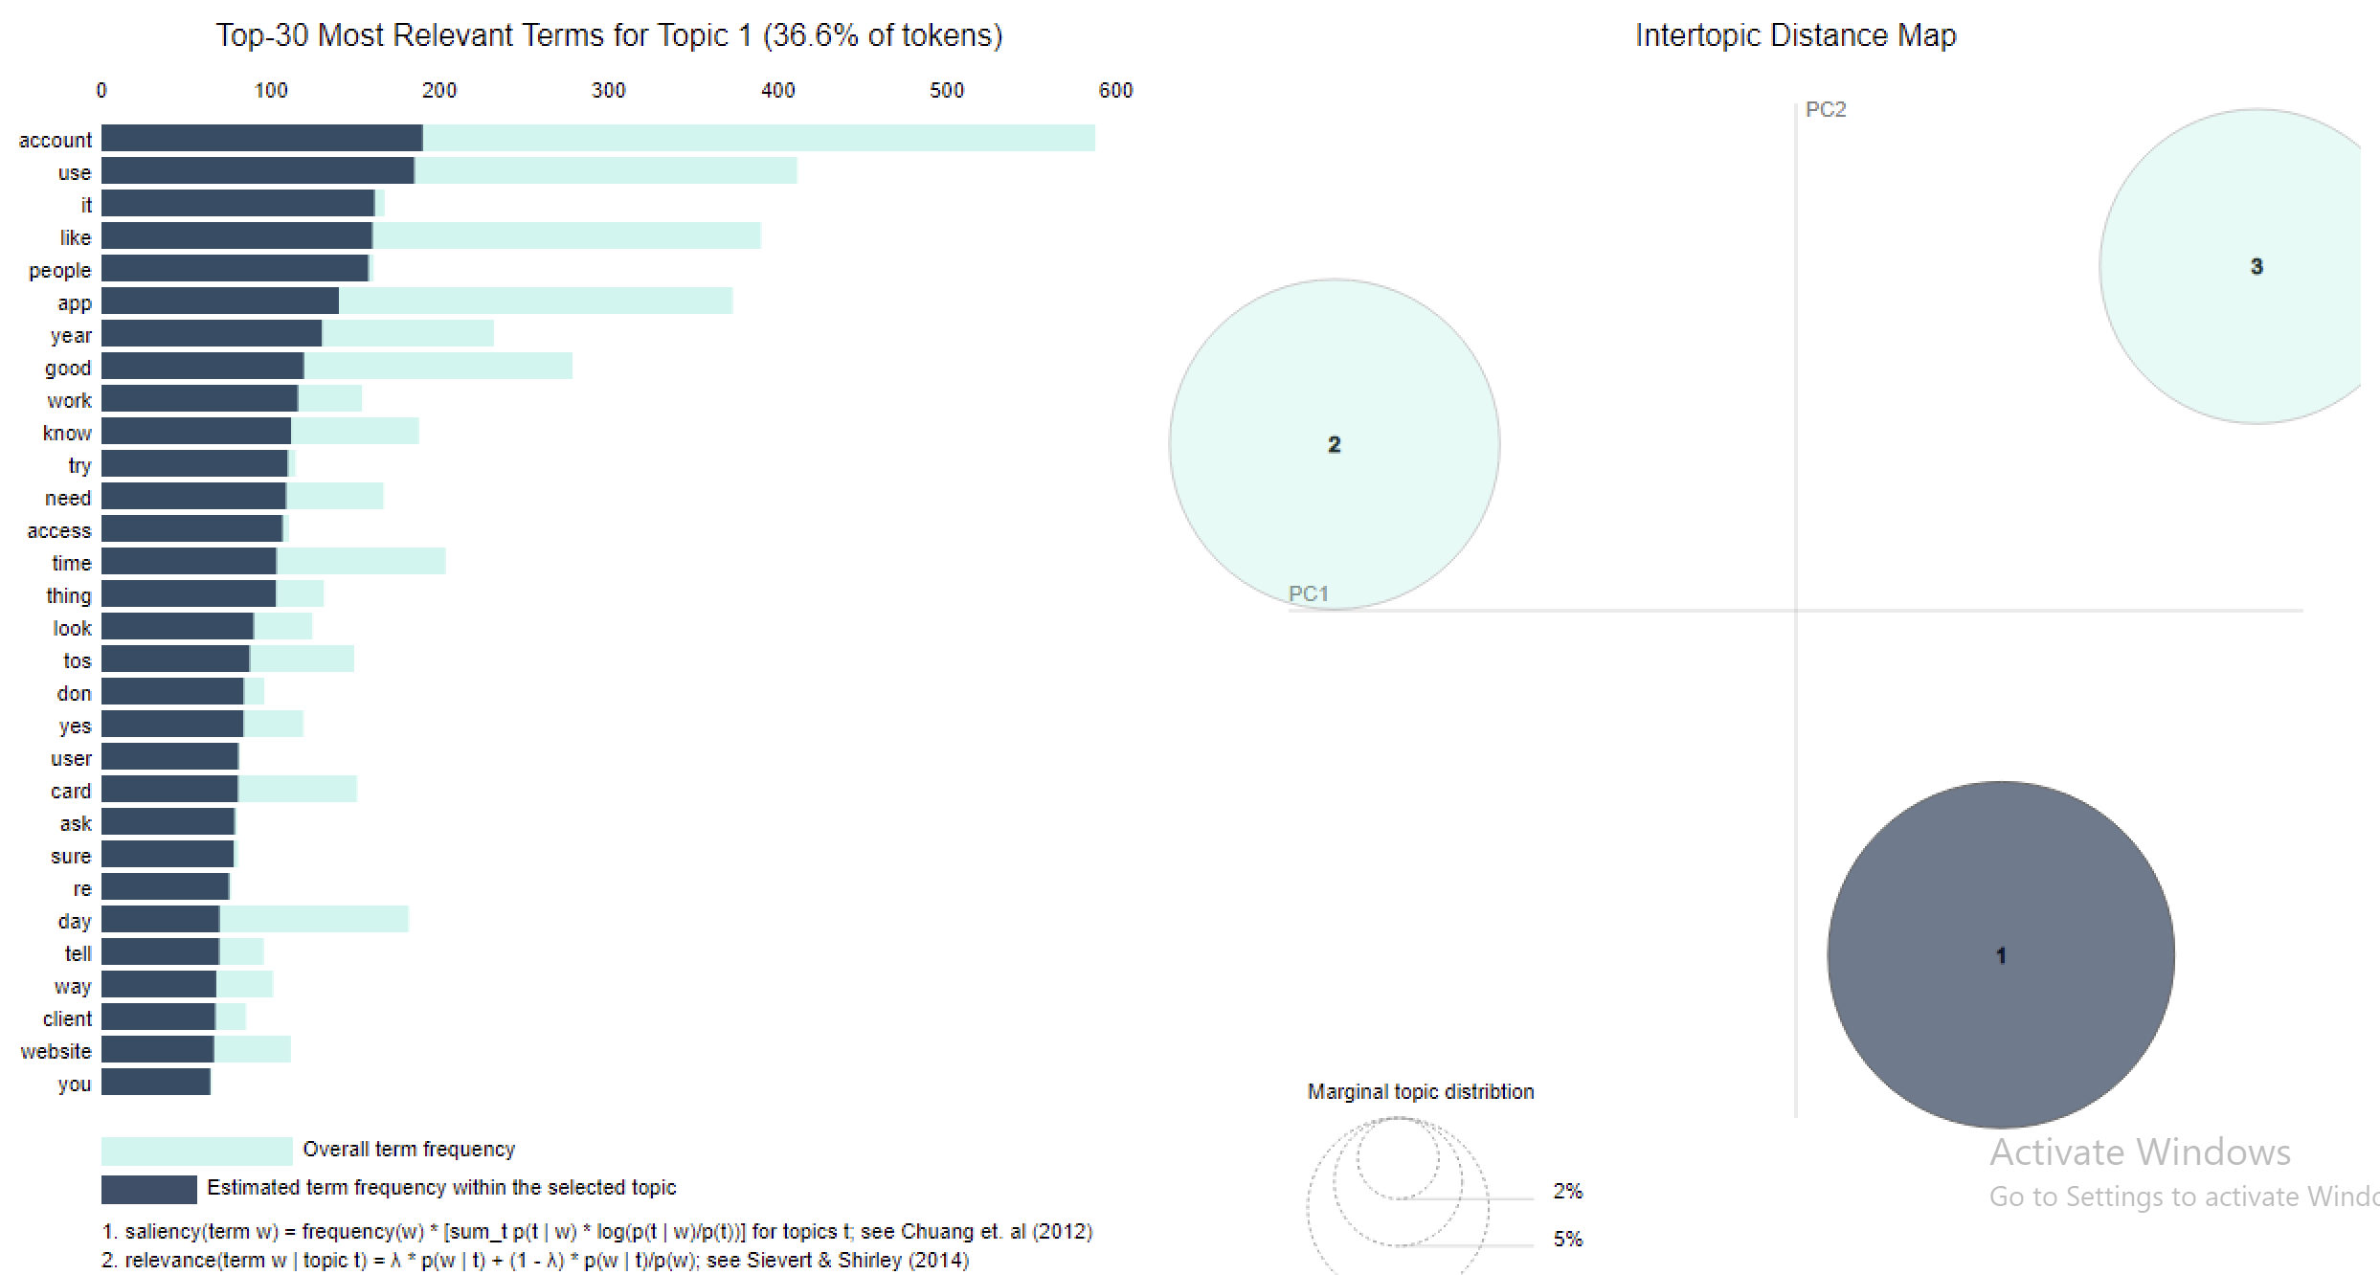
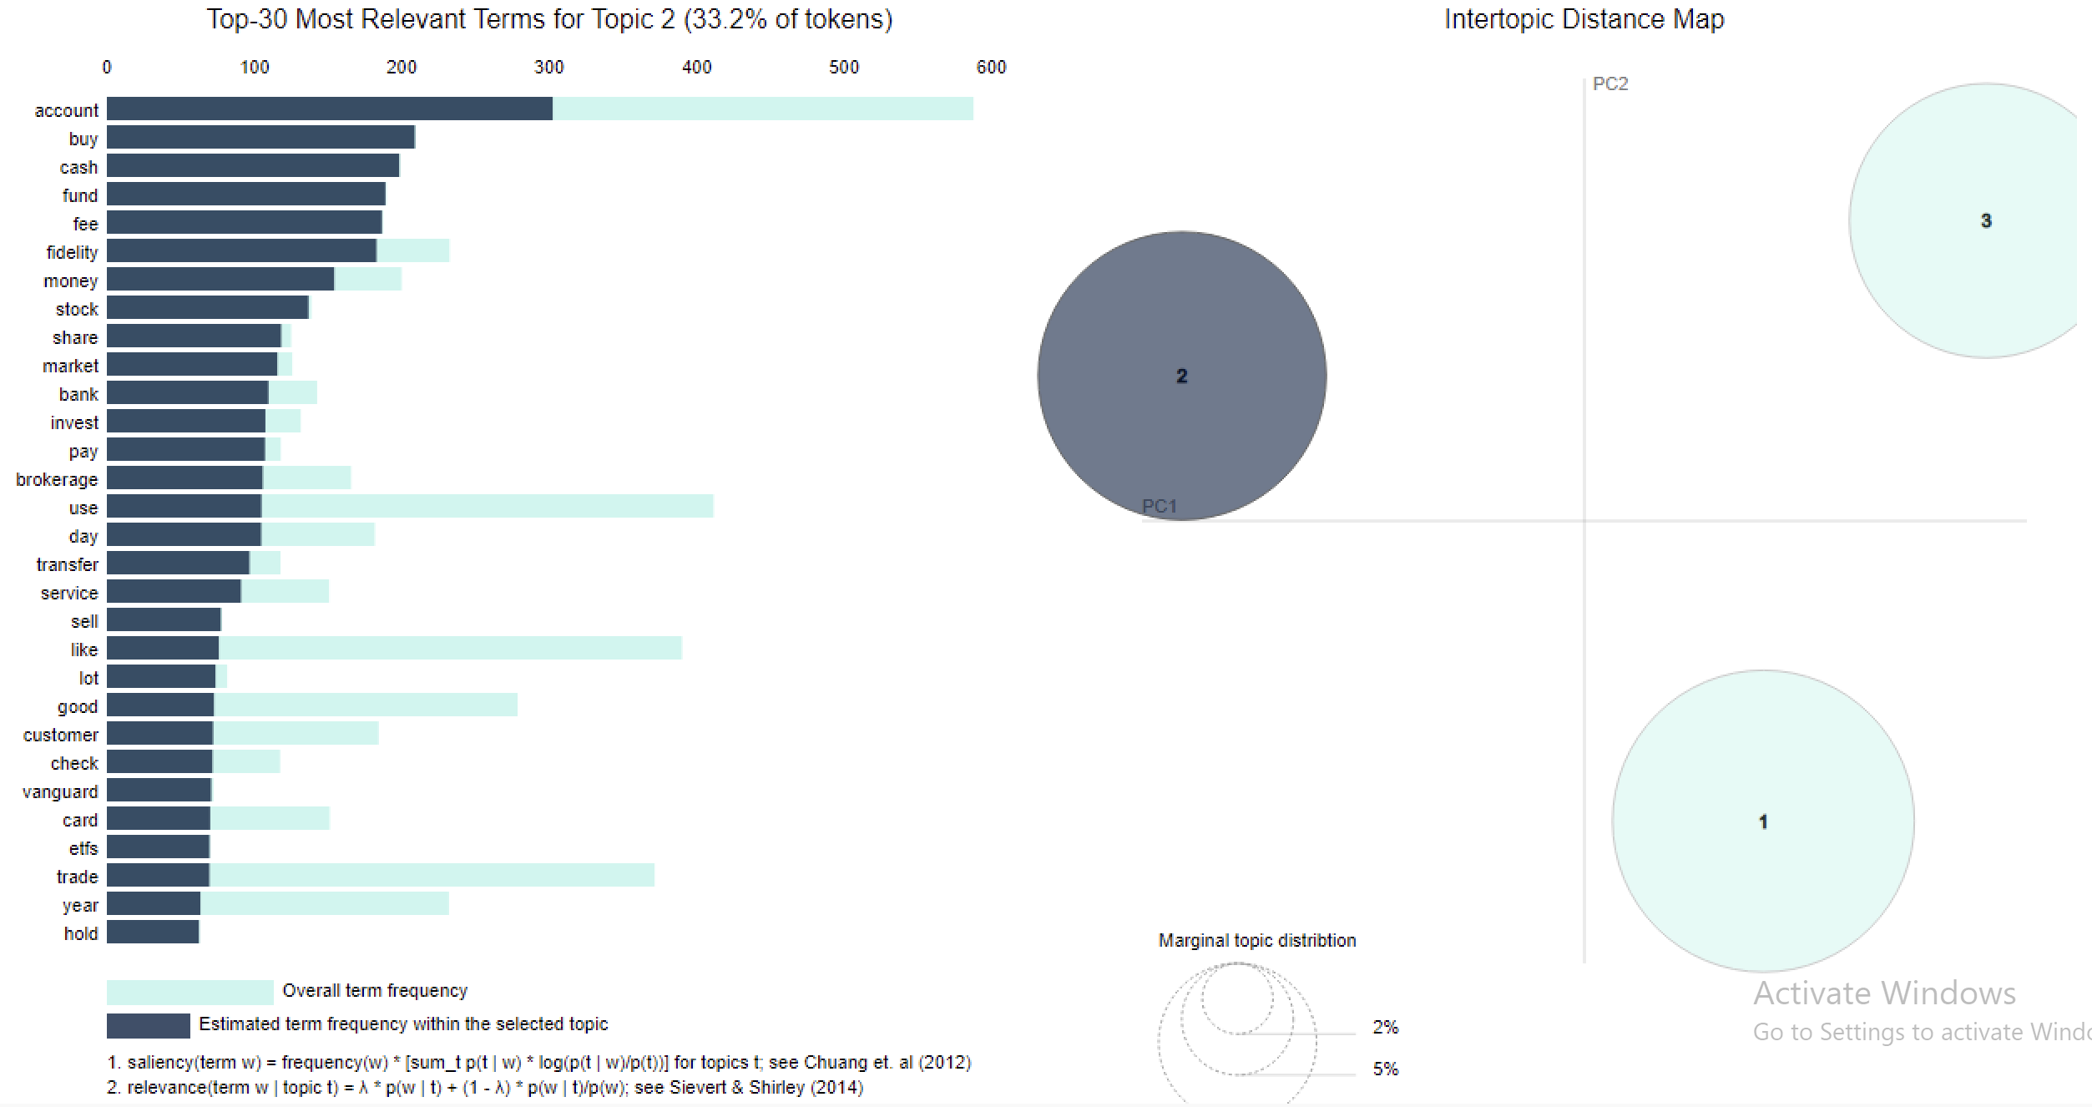
Topic Modeling (on comments)
Topic 1: General Account Management/Customer Experience
Topic 2: Financial Transactions and Investment Options
Notes:
Topic 1 including terms like “account,” “use,” app,” people,” and ”need” revolves around account management and user interactions with Schwab’s services
Focus on accessibility and usability of accounts and apps
Topic 2 including terms centered around more specific financial activities such as “buy,” “cash,” ”fund,” “invest,” and “market”
Focus on the transactional and investment side of Schwab’s services, discussing topics like buying stocks, handling cash, and investment strategies

Slide 8
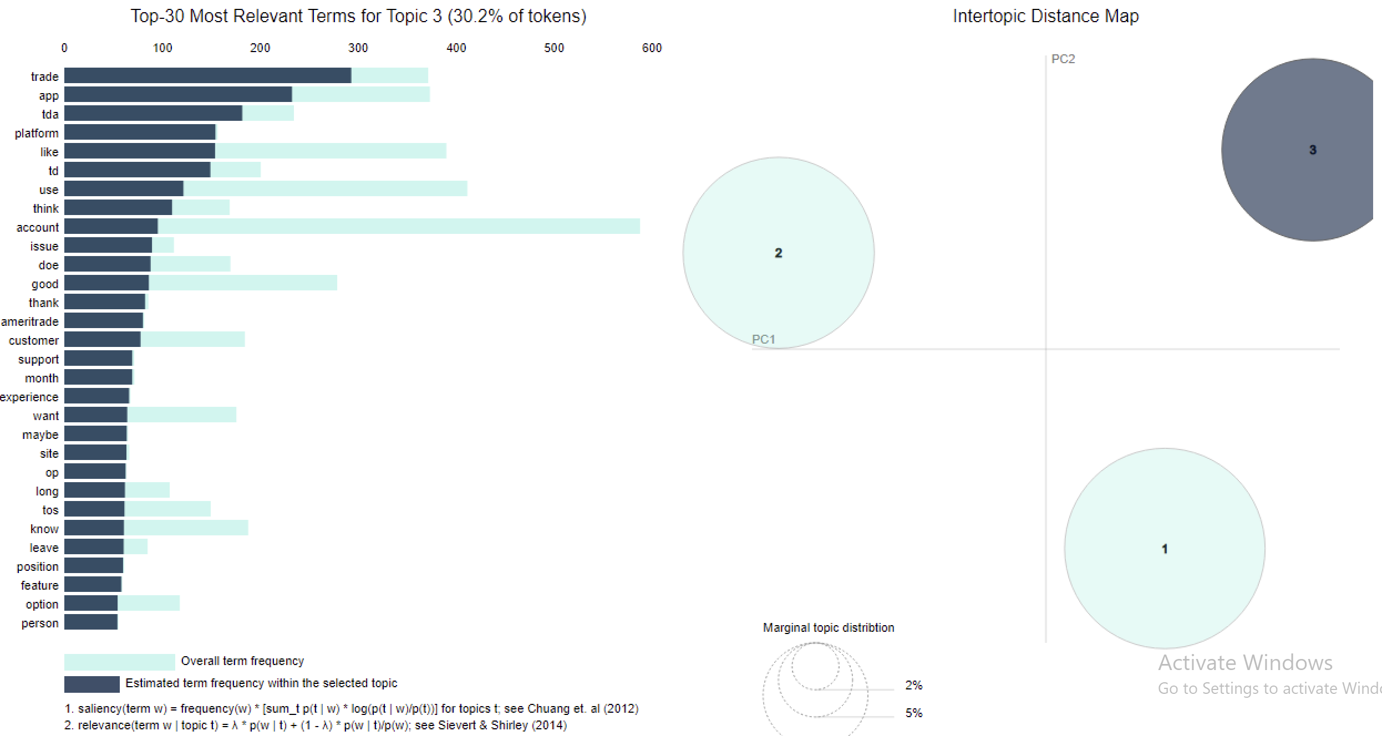
Topic Modeling
Topic 3: Trading Platforms and Customer Support
Notes:
Topic 3 including terms like “trade,” “app,” “platform,” “customer,” and ”support”
- Focused on the trading platforms themselves and the support provided to users. Also compares Schwab with competitors suggesting user comparisons of features and services

Slide 9
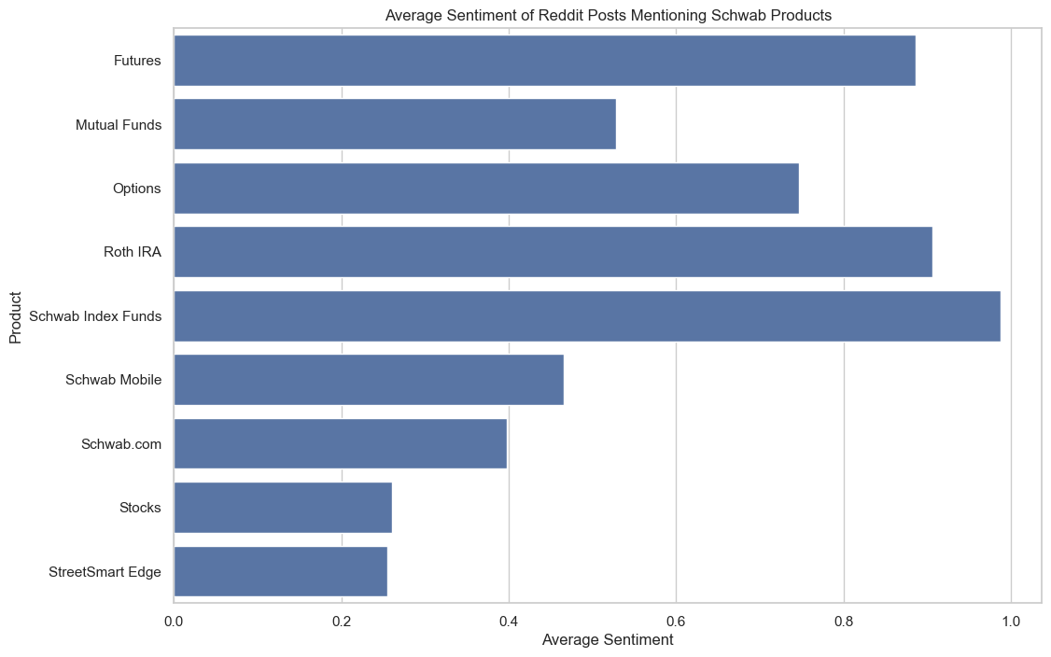
Average Sentiment of Reddit Posts Mentioning Schwab Products

Slide 10
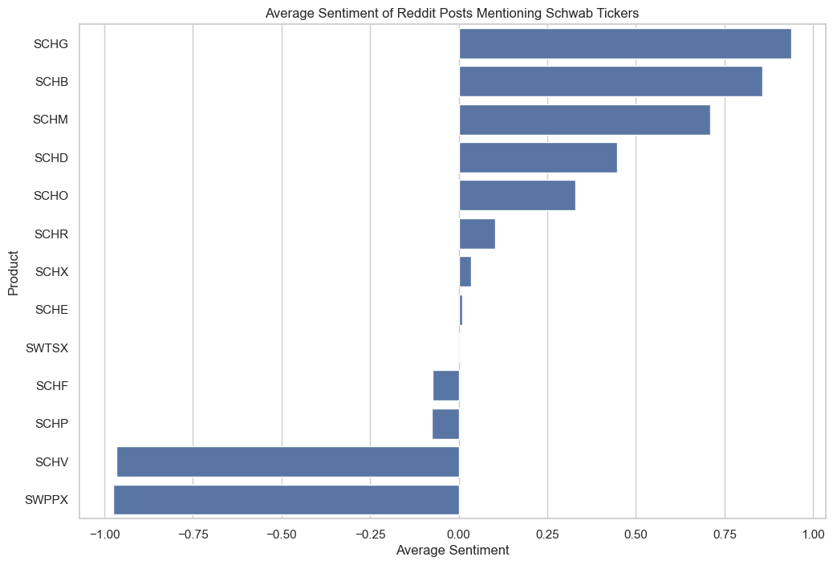
TICKER SENTIMENT

Slide 11

Key Area’s of Business Improvement
Theme Modeling
Integration and Enhancement of Trading Platforms
Customer Service and User Experience Improvements
Enhance Mobile Experience
Expand Educational Resources
Improve Customer Service
Enhance Customization and Personalization
Community Building
Notes:
1. Enhanced Mobile Experience
- While improvements have been made, the topic models indicate a strong focus on mobile app usability and features. Users discuss aspects like "account," "app," and "use," pointing to the central role of mobile platforms in their interaction with Schwab.
Recommendation: Continue to innovate in the mobile space by enhancing the app's interface and usability. This could include more intuitive navigation, faster loading times, and more personalized features such as AI-driven insights into personal investment performance. Maybe even more customization and personalization
2. Expanded Educational Resources:
- Discussions around terms like "trade," "invest," and comparisons with platforms like "Ameritrade" suggest a need for robust educational tools that help users make informed decisions.
Recommendation: Develop a more comprehensive suite of educational resources, possibly leveraging the thinkorswim platform's capabilities. These could include interactive tutorials, webinars, and real-time trading simulations tailored to different levels of investment knowledge.
3. Improved Customer Service:
- Terms like "support" and "customer" are prevalent, which can indicate concerns about customer service experiences.
Recommendation: Invest in advanced customer service technologies, such as AI chatbots integrated with a deep learning system to provide quick and efficient responses. Enhance the training of customer service representatives to handle complex queries, especially those related to trading and investment strategies.
4. Community Building:
- Discussions in forums and social media suggest users value community opinions and shared experiences.
Recommendation: Create more opportunities for community engagement through forums, user groups, or virtual meetups. These platforms can facilitate peer-to-peer learning and support, fostering a stronger community of traders and investors.
Weekly AMA's (ask me anything)

Slide 12

Thank you!
Q&A

Slide 13
Dashboard Backup Link
https://app.powerbi.com/links/XHYqEGLuQw?ctid=6f3c7037-85c2-40e6-9dec-18b02d289288&pbi_source=linkShare&bookmarkGuid=ac12871d-a626-414b-8d47-895fe53d77b0

